Slide 1
Quantitative Genetics:
From Genes to Complex Phenotypes and their Evolution
Genética Quantitativa: de Genes a Fenótipos Complexos e Sua Evolução

Slide 2
People
Jason Wolf (Univ Bath, UK)
Gabriel Marroig (USP)
Alastair Wilson (Univ. Exeter, Brazil)
José Álvarez-Castro
Diogo Melo (USP)

Slide 3
Topics
Day 1 – components of quantitative genetic variation (Wilson)
  Linking alleles to trait variation
  Decomposing variation
  Estimating variance components
Day 2 – genetic architecture (Wolf)
  Molecular quantitative genetics
  Estimation of genetic effects
  Analysis of quantitative trait loci

Slide 4
Topics
Day 3 – multivariate concepts (Marroig)
  Pleiotropy and correlated traits
  Genetic variance-covariance structure
  Multivariate evolution
Day 4 – Gene interactions (Álvarez-Castro)
  Multiple loci and epistasis
  Analysis and interpretation of patterns of gene interactions
  Evolutionary implications of epistasis

Slide 5
Quantitative vs ‘Mendelian’ genetics
Mendel described ‘particulate’ inheritance
  Law of Segregation
  Law of Independent assortment
Focused on ‘qualitative’ traits
  Classify phenotypes into discrete classes
In modern genetics
  ‘Genes of major effect’
  Loss of function (KO) mutants
  Distinct phenotypic differences

Slide 6
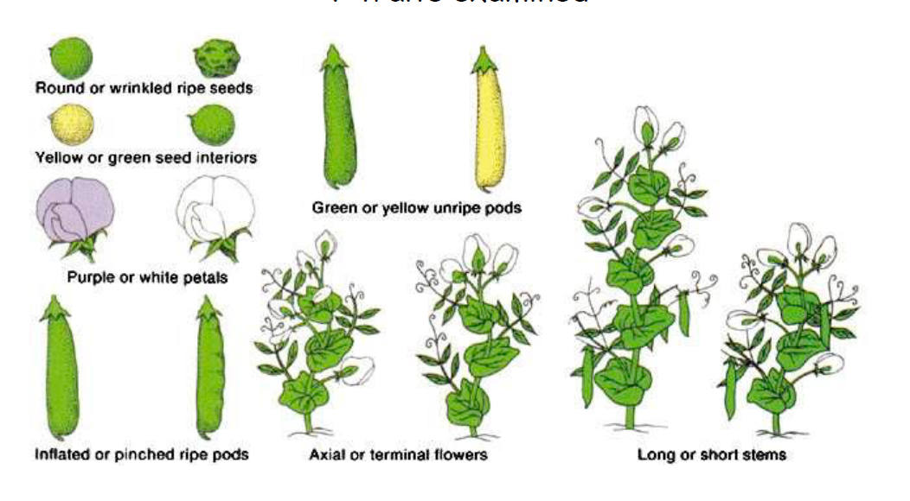
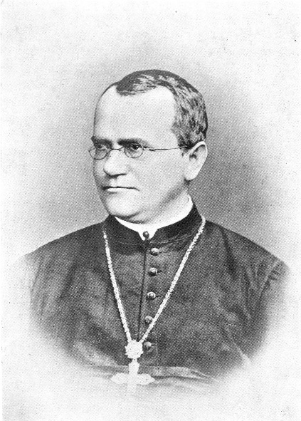

Slide 7
Quantitative genetics?
Study of (genetic) variation in ‘complex’ traits
  Typically with continuous distributions
Historically tied to “breeders’” genetics
  selection for animal and plant improvement
Now more broadly focused on understanding the genetic basis to complex traits
  And evolutionary implications

Slide 8
Complex traits?
  many genes
  gene interactions
  environmental effects
  gene-environment interactions
  epigenetic effects
For example, consider body size (weight)
  composite trait (sum of all body parts)
  Affected by: hormones, metabolism, grow factors, developmental timing, organismal shape etc.

Slide 9
Genes to distributions
With many Mendelian factors underlying a single trait, we lose discrete identifiable categories
Can understand genetics and inheritance as a statistical problem
Consider:
  Each locus has two alleles with similar frequencies
  The alleles are codominant (additive)

Slide 10
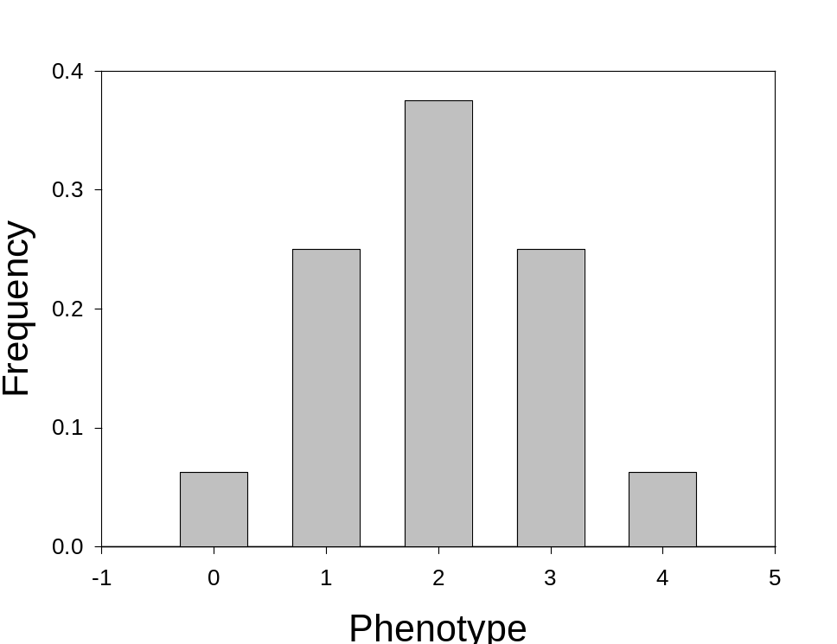
Two loci

Slide 11
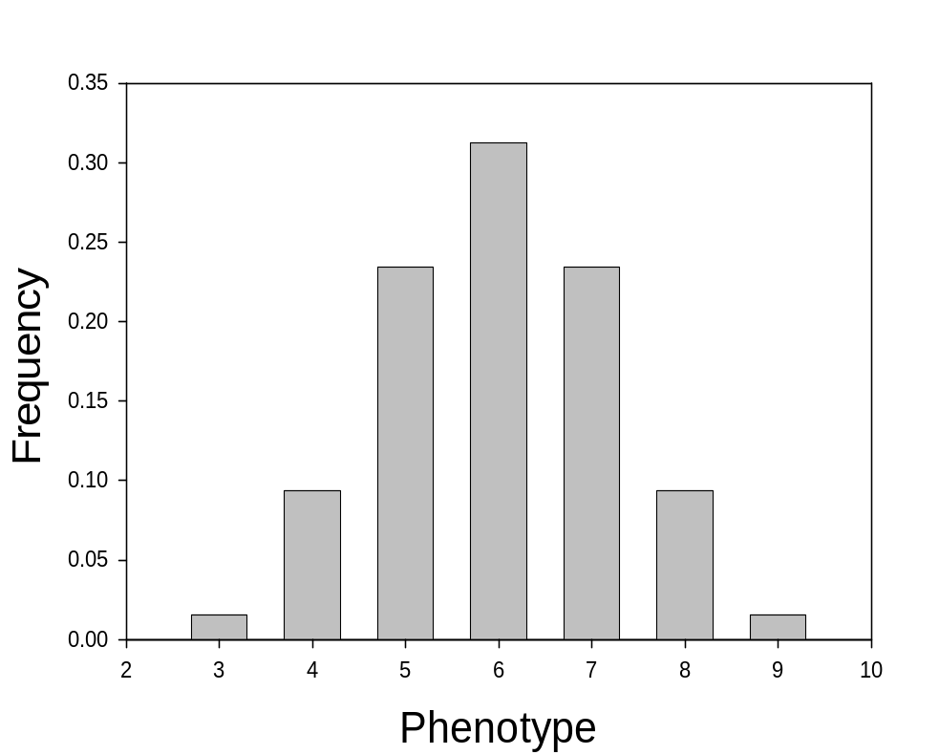
Three additive loci

Slide 12
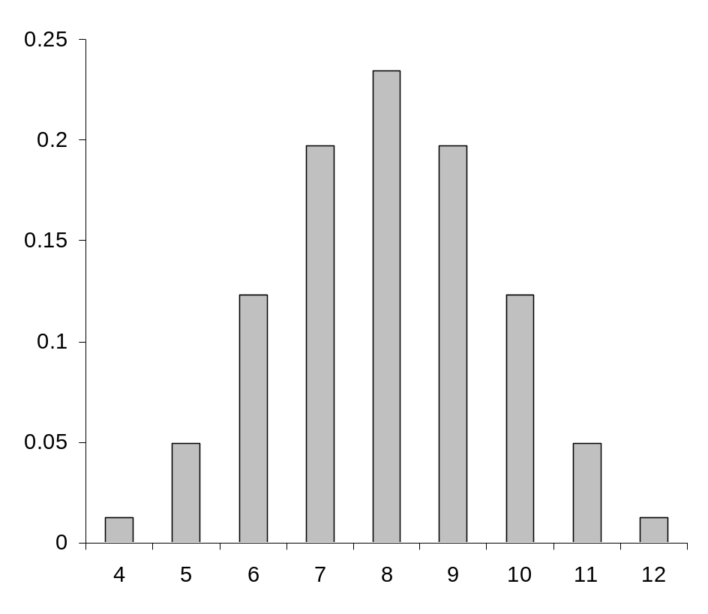
Four additive loci

Slide 13
Biology is ‘noisy’
Traits typically show some random error or noise
  One genotype produces a distribution of phenotypes
  Gene expression and development are imperfect
  Environmental heterogeneity adds noise
    E.g., nutrient availability affects size related traits

Slide 14
So we don’t see this…

Slide 15
… we see this

Slide 16
… we see this

Slide 17
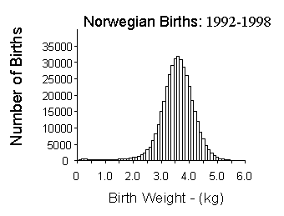
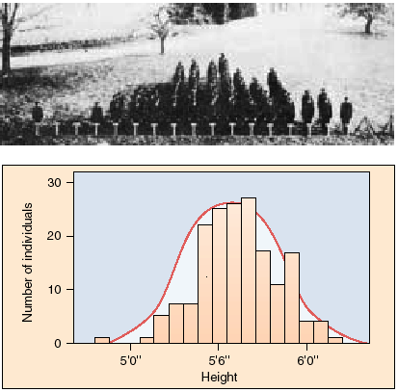
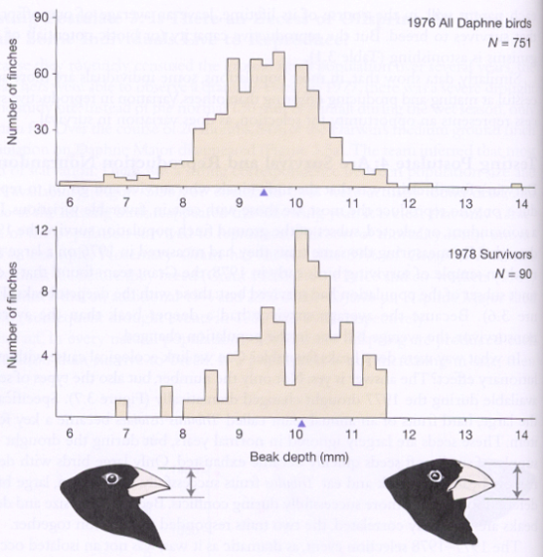
Distributions under polygenic inheritance
Connecticut Agricultural College Undergraduates, 1914

Slide 18
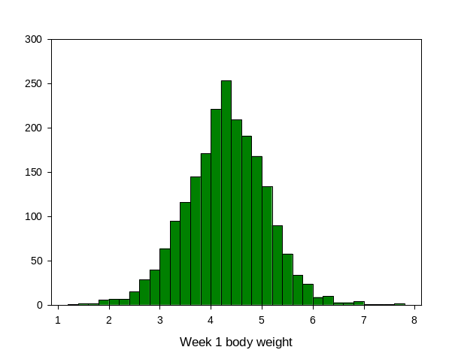
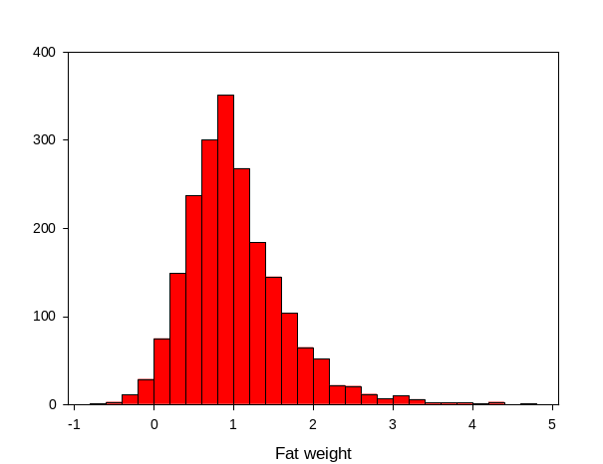
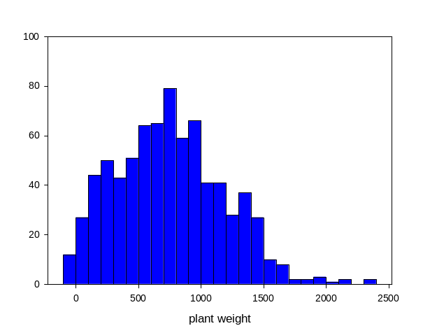
Quantitative traits
Mouse body weight
Fat pad weight (mice)
Total weight (Arabidopsis)

Slide 19
Mendelian inheritance
Genotype-phenotype relationship links molecular variation to patterns of phenotypic variation
  Say we have a locus (which we will call the A locus) with two alleles, A₁ and A₂
  We can examine how the locus influences the phenotype (i.e., the effect of the locus)
  …and examine the pattern of variation it creates in a population

Slide 20
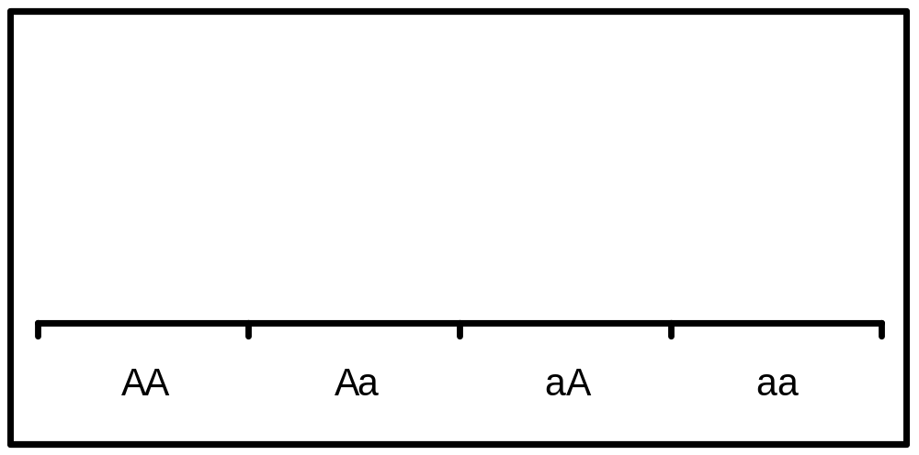
Simple (additive) effect
Assume A₁ allele leads to a ‘bigger’ trait (pea size) value than the A₂ allele
  Phenotype is the sum of the effects of two alleles
Phenotypes: A₁A₁ = 3, A₁A₂ = 2 and A₂A₂ = 1
3-
Phenotype
2-
1-
A₁A₁ A₁A₂ A₂A₂
Genotype

Slide 21
From genotypes to statistical genetics
A locus contributes to statistical properties of a trait in relation to the frequencies of the genotypes (and hence alleles)
Assume the population is in Hardy-Weinberg proportions, then:
  F(A₁A₁) = p²
  F(A₁A₂) = 2pq
  F(A₂A₂) = q²

Slide 22
From genotypes to statistical genetics
So we expect the three phenotypes to appear in these proportions
We can calculate the expected mean and variance of the phenotype
  And they will depend on the frequencies
  Same ‘physiological’ influence of a locus produces different statistical measures

Slide 23
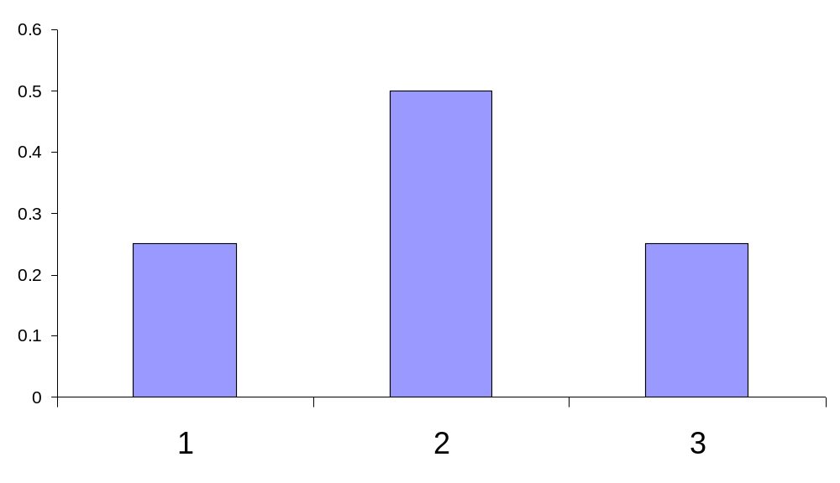
Statistical properties
Distribution of pea sizes in a population where the frequency of the A₁ allele is the same as the A₂ allele
  p = q = 0.5 (p² = 0.25, 2pq = 0.5, q² = 0.25)
mean size = 2.0
variance = 0.5
Frequency
Pea size (grams)

Slide 24
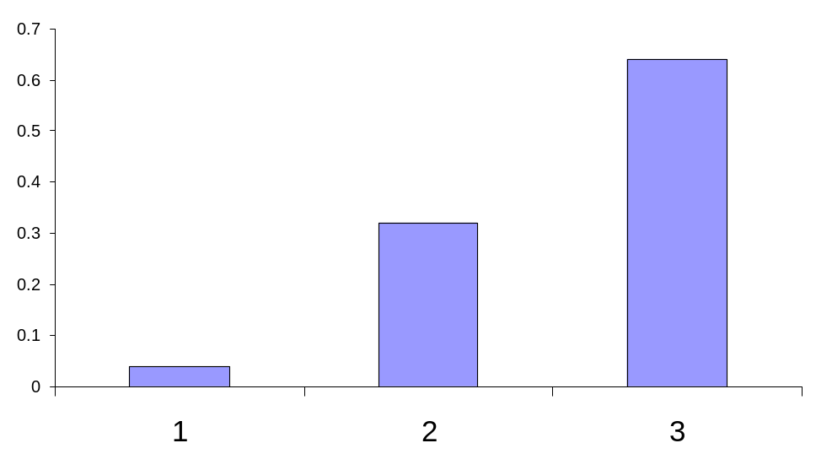
Frequency dependent
Of course, one allele could be more common (say the p = 0.8, so the A₁ allele is more common than A₁)
  p = 0.8 q = 0.2 (p² = 0.64, 2pq = 0.32, q² = 0.04)
mean size = 2.6
variance = 0.32
Frequency
Pea size (grams)

Slide 25
Studying variation
So we can study genetic variation statistically (whichis ultimately caused by variation among genotypic classes at many loci)
Frequency
Pea size (grams)

Slide 26
‘Heritable variation’
How does a locus contribute to resemblance of parents and offspring
Offspring inherit alleles, not genotypes
  need to understand how sharing alleles leads to sharing of phenotypes

Slide 27
Heritable variation
Measure the heritable effects of the alleles at a locus
‘Average effect’ of an allele
  can be measured as the average phenotype of an allele (as a deviation from the population mean)
    assume second allele is randomly sampled (assume HWE)

Slide 28
Average effect of an allele
Measures how inheriting an allele affects the phenotype of an individual
Is formally defined by the regression of the phenotype on the number of copies of an allele
  Mean phenotype definition (mentioned earlier) is technically the average excess of an allele, but the two are equivalent unless the population is inbred

Slide 29
Average effect of an allele substitution
Average effect of an allele substitution
Phenotype
slope is the average effect of substituting the A₁ allele for the A₂ (α)
0 1 2
A₂A₂ A₁A₂ A₁A₁
Number of A₁ alleles
Genotype

Slide 30
Average effects
Average effects depend on allele frequencies
Hence average effect of an allele substitution is a property of a population, not the alleles per se
An allele substitution can have a large effect on one population and little or no effect in another population

Slide 31
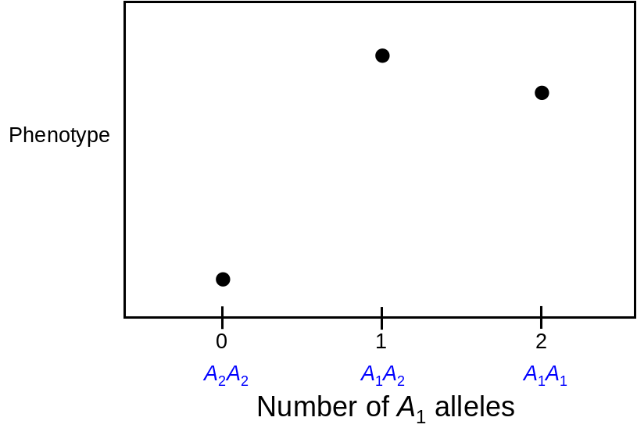
Effects are population specific
A₁ allele is rare
A₁ allele is common
if p = 0.1, then
q² = 0.81, 2pq = 0.18, p² = 0.01
if p = 0.9, then
q² = 0.01, 2pq = 0.18, p² = 0.81

Slide 32
The heritable variance
Twice the variance in average effects of alleles is the heritable (additive genetic) variance
Critical because it is a measure of the variation that contributes to resemblance of parents and offspring (and all other types of relatives)
  Relates sharing of alleles to phenotypic resemblance / similarity

Slide 33
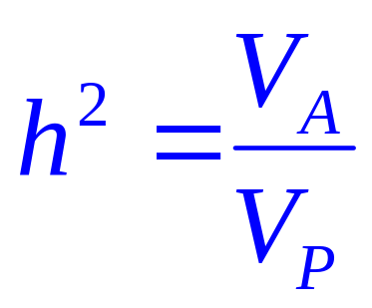
Heritability
‘heritability’ can be defined as the proportion of variation that contributes to parent-offspring resemblance
  i.e., the proportion of variation that is additive genetic
  This is the ‘narrow-sense’ heritability

Slide 34
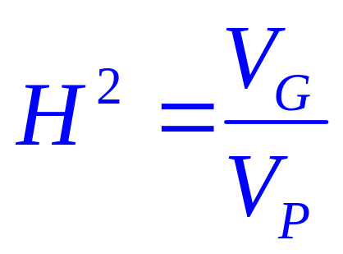
Broad-sense heritability
We may also want to know how much of all variation can be attributed to genetic influences
  This is the ‘broad-sense’ heritability

